Slide 1
Managing in a Global Environment
Management
Stephen P. Robbins Mary Coulter
tenth edition
Chapter
4

Slide 2
Learning Outcomes
Follow this Learning Outline as you read and study this chapter.
4.1 What’s Your Global perspective?
  Define parochialism.
  Contrast ethnocentric, polycentric, and geocentric attitudes towards global business.
4.2 Understanding The global Environment
  Describe the current status of the EU, NAFTA, ASEAN and other Regional Trade Allowances.
  Discuss the role of the WTO.

Slide 3
Learning Outcomes
4.3 Doing Business Globally
  Contrast multinational, multidomestic, global, transnational, and born global organizations.
  Describe the different ways organizations can go international.
4.4 Managing In A Global Environment.
  Explain how the global legal-political and economic environments affect managers.
  Discuss Hofstede’s five dimensions for assessing cultures.
  Describe the challenges of doing business globally in today’s world.

Slide 4
Learning Outcomes
4.4 Managing In A Global Environment.
  Explain how the global legal-political and economic environments affect managers.
  Discuss Hofstede’s five dimensions for assessing cultures.
  Describe the challenges of doing business globally in today’s world.

Slide 5
The Global Marketplace
Opportunities and Challenges
  Coping with the sudden appearance of new competitors
  Acknowledging cultural, political, and economic differences
  Dealing with increased uncertainty, fear, and anxiety
  Adapting to changes in the global environment
  Avoiding parochialism

Slide 6
What’s Your Global Perspective?
Parochialism
  Is viewing the world solely through one’s own eyes and perspectives.
  Is not recognizing that others have different ways of living and working.
  Is a significant obstacle for managers working in a global business world.
  Is falling into the trap of ignoring others’ values and customs and rigidly applying an attitude of “ours is better than theirs” to foreign cultures.

Slide 7
Adopting a Global Perspective
Ethnocentric Attitude
  The parochialistic belief that the best work approaches and practices are those of the home country.
Polycentric Attitude
  The view that the managers in the host country know the best work approaches and practices for running their business.
Geocentric Attitude
  A world-oriented view that focuses on using the best approaches and people from around the globe.

Slide 8
Regional Trading Agreements
The European Union (EU)
  A unified economic and trade entity
    Belgium, Denmark, France, Greece, Ireland, Italy, Luxembourg, the Netherlands, Portugal, Spain, the United Kingdom, Germany, Austria, Finland, and Sweden
North American Free Trade Agreement (NAFTA)
  Eliminated barriers to free trade (tariffs, import licensing requirements, and customs user fees)
    United States, Canada, and Mexico

Slide 9
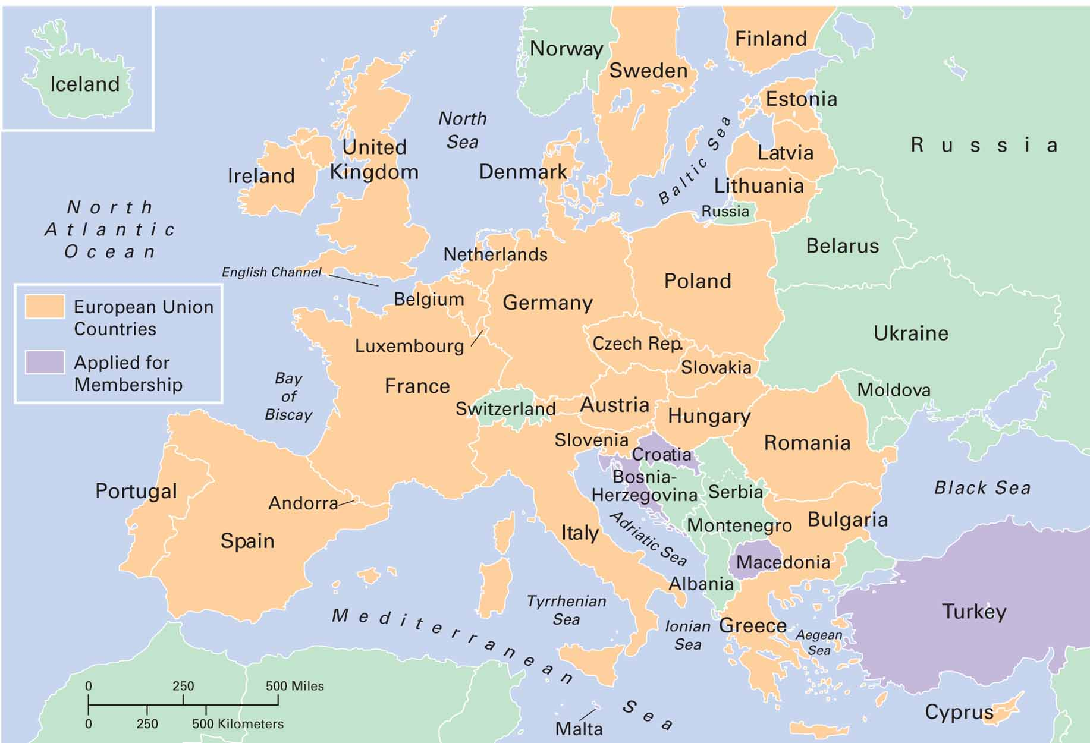
Exhibit 4–1 European Union

Slide 10
Regional Trading Agreements
U.S.-Central America Free Trade Agreement (CAFTA)
Free Trade Area of the Americas
Southern Cone Common Market (Mercosur)
Association of Southeast Asian Nations (ASEAN)
  Trading alliance of 10 Southeast Asian nations
African Union
South Asian Association for Regional Cooperation (SARRC)

Slide 11
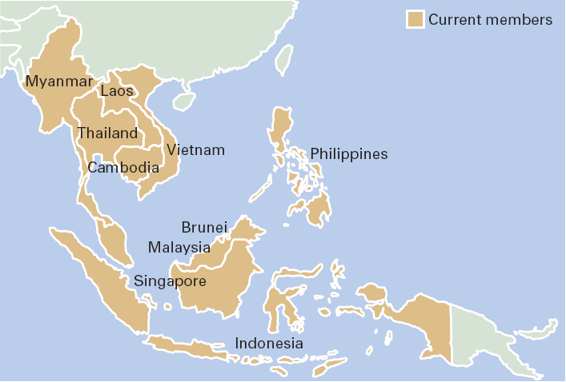
Exhibit 4–2 ASEAN Members
Source: Based on J. McClenahen and T. Clark, “ASEAN at Work,” IW. May 19, 1997, p. 42.

Slide 12
The World Trade Organization (WTO)
Evolved from the General Agreement on Tariffs and Trade (GATT) in 1995.
Functions as the only global organization dealing with the rules of trade among nations.
Has 149 member nations and 32 observer governments.
Monitors and promotes world trade.

Slide 13
Different Types of International Organizations
Multinational Corporation (MNC)
  Maintains operations in multiple countries.
Multidomestic Corporation
  Is an MNC that decentralizes management and other decisions to the local country.
Global Company
  Is an MNC that centralizes its management and other decisions in the home country.

Slide 14
Different Types of International Organizations (cont’d)
Transnational Corporation (Borderless Organization)
  Is an MNC that has eliminated structural divisions that impose artificial geographic barriers and is organized along business lines that reflect a geocentric attitude.

Slide 15
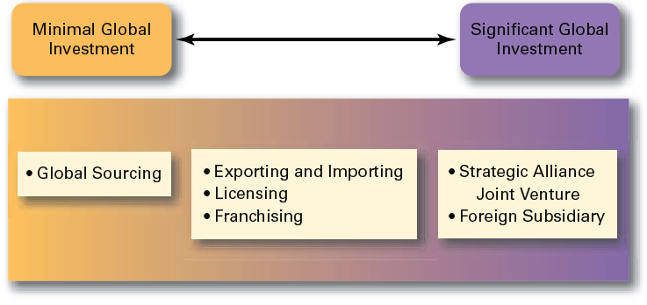
Exhibit 4–3 How Organizations Go Global

Slide 16
Other Forms of Globalization
Strategic Alliances
  Partnerships between and organization and a foreign company in which both share resources and knowledge in developing new products or building new production facilities.
Joint Venture
  A specific type of strategic alliance in which the partners agree to form a separate, independent organization for some business purpose.
Foreign Subsidiary
  Directly investing in a foreign country by setting up a separate and independent production facility or office.

Slide 17

Managing in A Global Environment
The Legal Environment
  Stability or instability of legal and political systems
    Legal procedures are established and followed
    Fair and honest elections held on a regular basis
  Differences in the laws of various nations
    Effects on business activities
    Effects on delivery of products and services

Slide 18
The Economic Environment
Economic Systems
  Free market economy
    An economy in which resources are primarily owned and controlled by the private sector.
  Planned economy
    An economy in which all economic decisions are planned by a central government.
Monetary and Financial Factors
  Currency exchange rates
  Inflation rates
  Diverse tax policies

Slide 19
The Cultural Environment
National Culture
  Is the values and attitudes shared by individuals from a specific country that shape their behavior and their beliefs about what is important.
  May have more influence on an organization than the organization culture.

Slide 20
Exhibit 4–4 What Are Americans Like
Americans are very informal.
Americans are direct.
Americans are competitive.
Americans are achievers.
Americans are independent and individualistic.
Americans are questioners.
Americans dislike silence.
Americans value punctuality.
Americans value cleanliness.
Sources: Based on M. Ernest (ed.), Predeparture Orientation Handbook: For Foreign Students and Scholars Planning to Study in the United States (Washington, DC: U.S. Information Agency, Bureau of Cultural Affairs, 1984), pp. 103–05; A. Bennett, “American Culture Is Often a Puzzle for Foreign Managers in the U.S.,” Wall Street Journal, February 12, 1986, p. 29; “Don’t Think Our Way’s the Only Way,” The Pryor Report, February 1988, p. 9; and B.J. Wattenberg, “The Attitudes behind American Exceptionalism,” U.S. News & World Report, August 7, 1989, p. 25.

Slide 21
Hofstede’s Framework for Assessing Cultures
Individualism
versus
Collectivism
Long-Term
versus
Short-Term Orientation
Power
Distance
Culture
Achievement versus Nurturing
Uncertainty
Avoidance

Slide 22
Exhibit 4–5 Hofstede’s Five Dimensions of
National Culture
(1) Individualistic — people look after their own and family interests
Collectivistic — people expect group to look after and protect them
Individualistic Collectivistic
United States, Canada Japan Mexico, Thailand
Australia
(2) High power distance—Accepts wide differences in power, great deal of respect for those in authority
Low power distance—Plays down inequalities: employees are not afraid to approach nor are in awe of the boss
High power distance Low power distance
Mexico, Singapore, Italy, Japan United States, Sweden

Slide 23
Exhibit 4–5 Hofstede’s Five Dimensions of
National Culture
(3) High uncertainty avoidance—Threatened with ambiguity and experience high levels of anxiety
Low uncertainty avoidance— Comfortable with risks; tolerant of different behavior and opinions
High uncertainty avoidance Low uncertainty avoidance
Italy, Mexico, France United Kingdom Canada, United States, Singapore
(4) Achievement—Values such as assertiveness, acquiring money and goods, and competition prevail
Nurturing—Values such as relationships and concern for others prevail
Achievement Nurturing
United States, Japan, Canada, Greece France, Sweden
Mexico

Slide 24
Exhibit 4–5 Hofstede’s Five Dimensions of
National Culture
(5) Long-term orientation—People look to the future and value thrift and persistence
Short-term orientation — People value tradition and the past
Short-term thinking Long-term thinking
Germany, Australia, China, Taiwan, Japan
United States, Canada

Slide 25
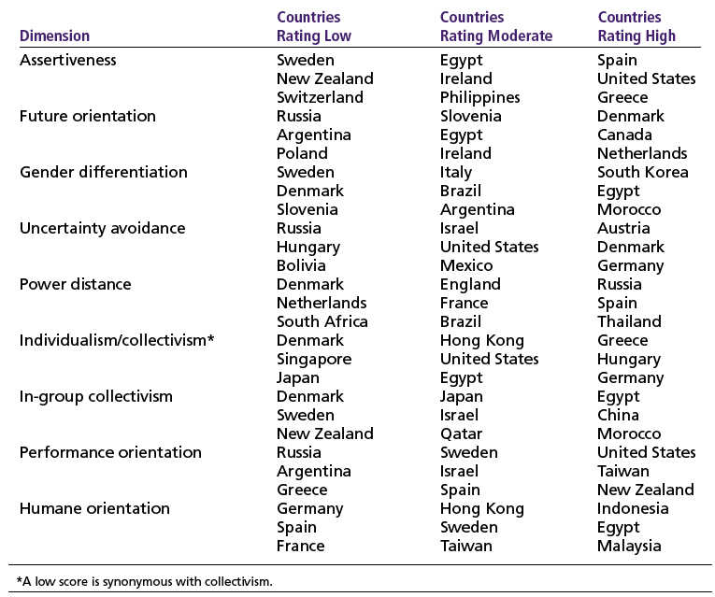
Exhibit 4–6 GLOBE Highlights
Source: M. Javidan and R. J. House, “Cultural Acumen for the Global Manager: Lessons from Project GLOBE,” Organizational Dynamics, Spring 2001, pp. 289–305. Copyright © 2001. Reprinted with permission from Elsevier.

Slide 26
Global Management in Today’s World
Challenges
  Openness associated with globalization
  Significant cultural differences (e.g., Americanization)
  Adjusting leadership styles and management approaches
Risks
  Loss of investments in unstable countries
  Increased terrorism
  Economic interdependence

Slide 27
Terms to Know
parochialism
ethnocentric attitude
polycentric attitude
geocentric attitude
European Union (EU)
Euro
North American Free Trade Agreement (NAFTA)
Association of Southeast Asian Nations (ASEAN)
World Trade Organization (WTO)
multinational corporations (MNCs)
multidomestic corporation
global company
transnational or borderless organization
born globals
global sourcing
exporting
importing
licensing
franchising
strategic alliances
joint venture
foreign subsidiary
market economy
command economy
national culture
GLOBE
wikis
blogs

Slide 28

All rights reserved. No part of this publication may be reproduced, stored in a retrieval system, or transmitted, in any form or by any means, electronic, mechanical, photocopying, recording, or otherwise, without the prior written permission of the publisher. Printed in the United States of America.

